Slide 2
Memory Organization of PIC18
TE2015 Microcontroladores

Slide 3
Data Memory and Program Memory
TE2015 Microcontroladores

Slide 4

PIC18 MEMORY ORGANIZATION
PIC18 Memory (Harvard)
PROGRAM
DATA
EEPROM
Banks
Fast SFR
Access RAM
2 MB FLASH
PC[20:0]
16 KB SRAM
BSR, ACCESS BANK
PERIPHERAL

Slide 5
Addressing Modes
TE2015 Microcontroladores

Slide 6
ADDRESSING MODES
Data in data memory can be addressed by the CPU using different paths. These paths are called Addressing Modes
Most instructions have a fixed addressing mode
Some other instructions may use up to three addressing modes
Addressing Modes
Inherent
Literal
Direct
Indirect
No need for an address
Explicit address is part of opcode
All or part pf source/destination address in opcode
SLEEP, RESET, DAW
ADDLW, MOVLW, CALL, GOTO
Use FSRs as pointers

Slide 7
DIRECT AND INDIRECT ADDRESSING
Direct. All or part of the source and/or destination address is within the opcode.
The options are specified by the arguments accompanying the instruction.
Bit-oriented and Byte-oriented instructions include 8-bit literal address as their LSB that specifies either a register address in one of the banks of data RAM or a location in the Access Bank
The Access RAM bit ‘a’ determines how the address is interpreted.
When ‘a’ is ‘1’, the BSR is used with the address to determine the complete 12-bit address of the register
When ‘a’ is ‘0’, the address is interpreted as being a register in the Access Bank
The destination of the operation’s results is determined by the destination bit ‘d’:
When ‘d’ is ‘1’, the results are stored back in the source register, overwriting its original contents.
When ‘d’ is ‘0’, the results are stored in the W register.
Indirect. Allows the user to access a location in data memory without giving a fixed address in the instruction. Instead, we use FSRs as pointers to the locations which are to be read or written.
Since FSRs are themselves located in RAM as Special File Registers, they can also be directly manipulated under program control. This makes FSRs very useful in implementing data structures, such as tables and arrays in data memory.

Slide 8
Bit
15
14
13
12
11
10
9
8
7
6
5
4
3
2
1
0
0
0
1
0
0
0
0
0
0
0
0
0
0
1
1
1
Opcode
Literal/Address/Pointer

Slide 9
Configuration Bits
TE2015 Microcontroladores

Slide 10
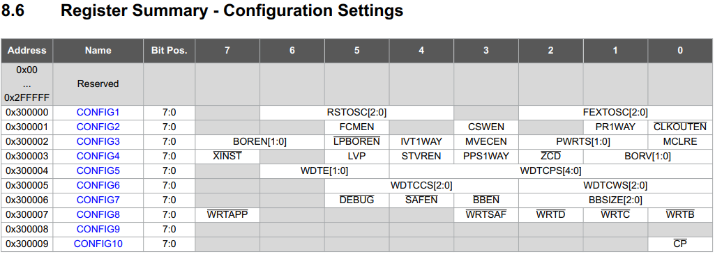
CONFIGURATION BITS

Slide 11
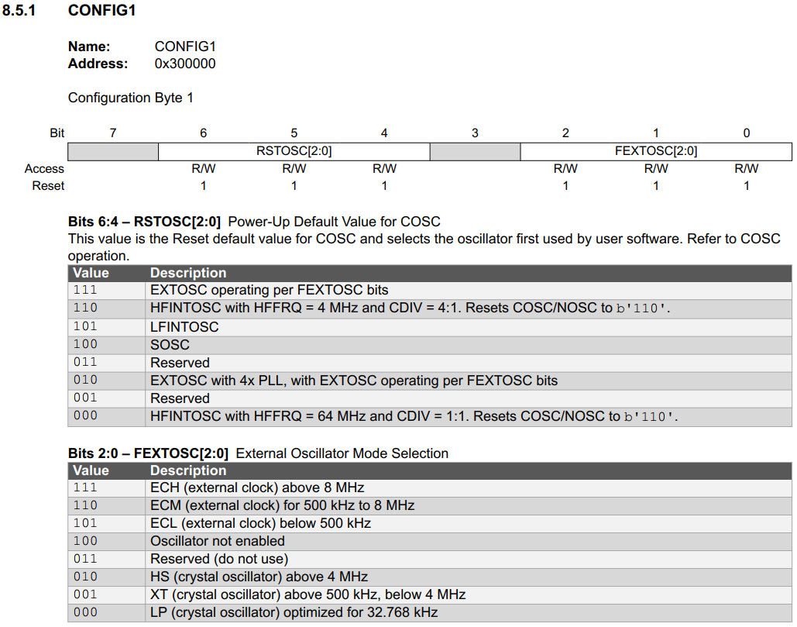
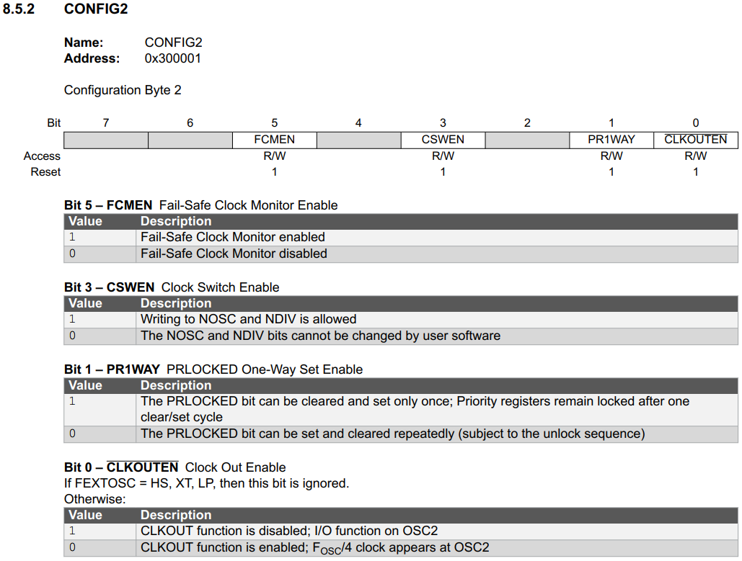
CONFIGURATION BITS

Slide 12
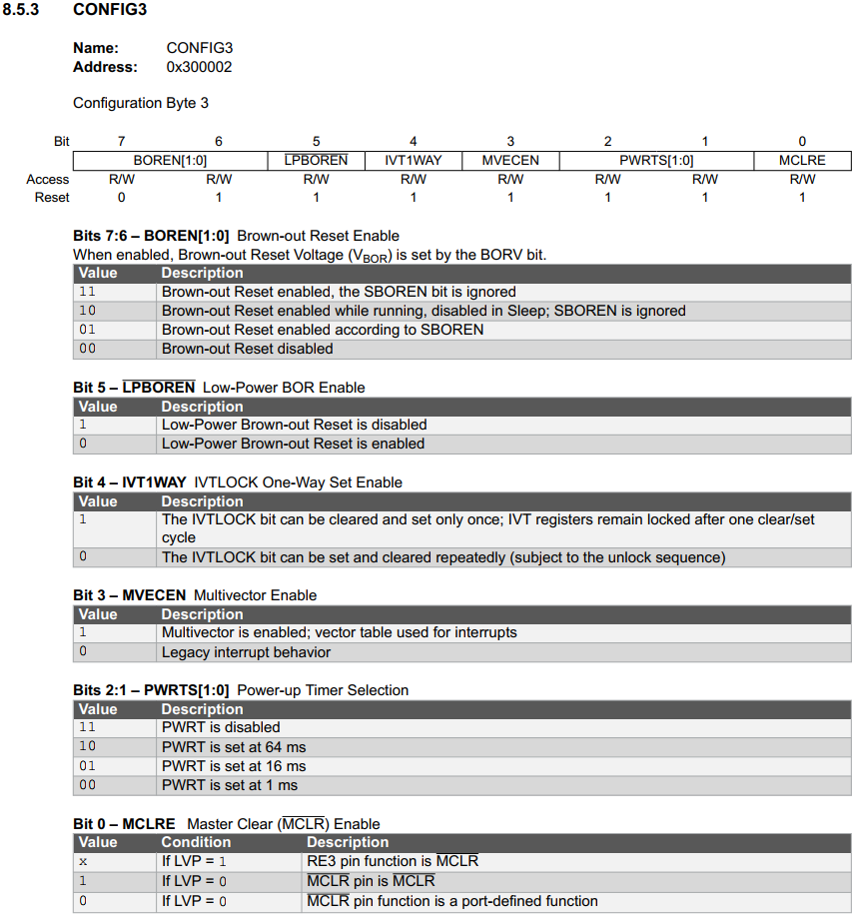
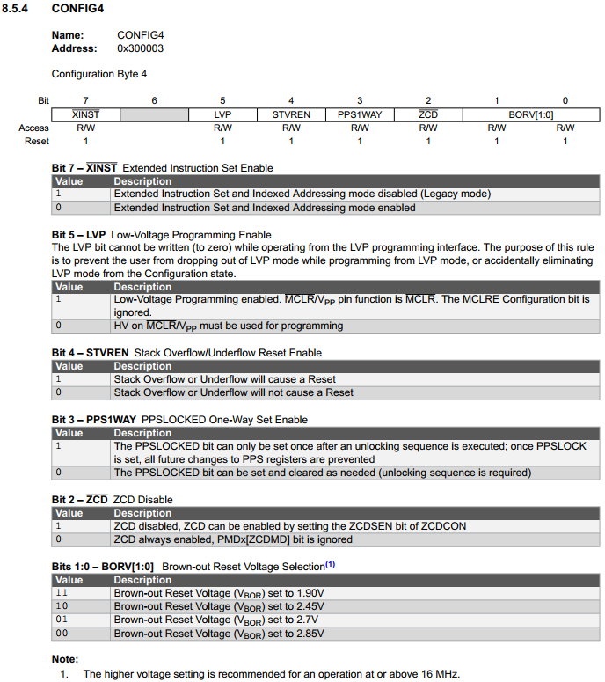
CONFIGURATION BITS

Slide 13
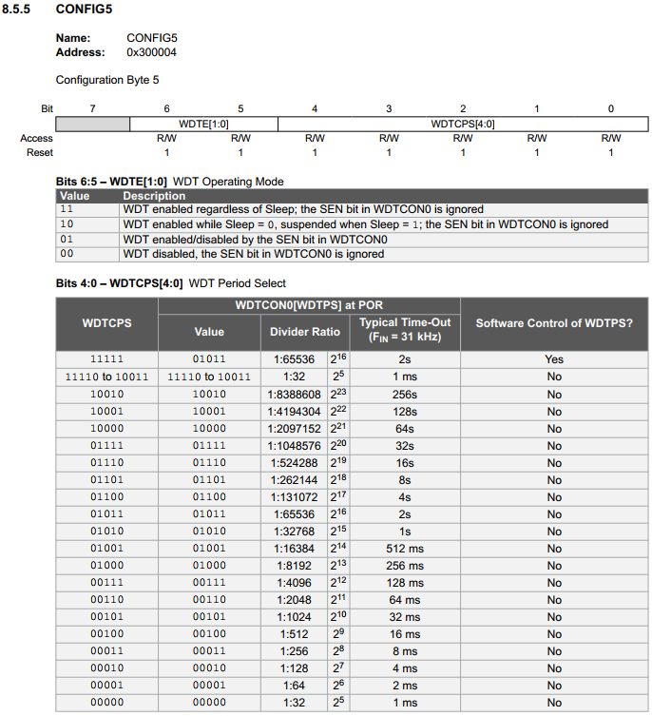
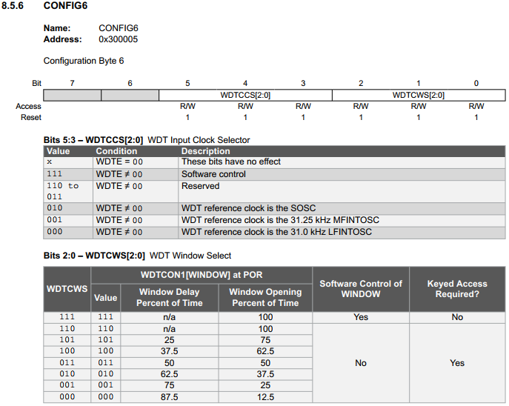
CONFIGURATION BITS

Slide 14
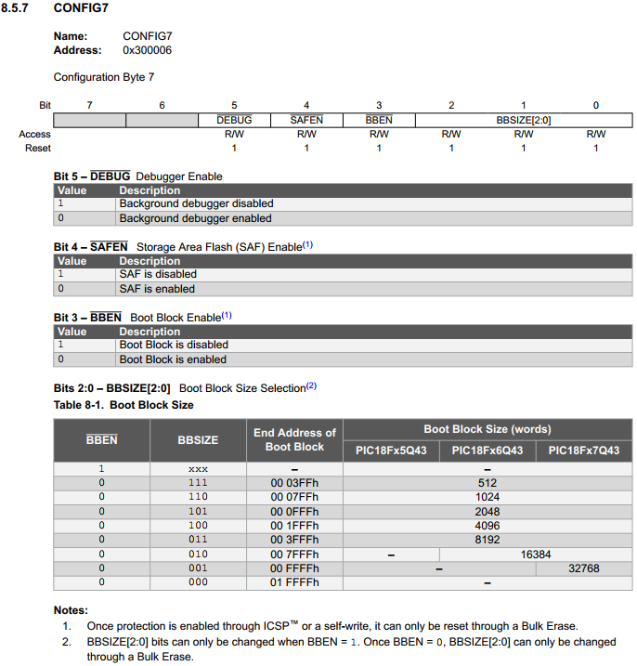
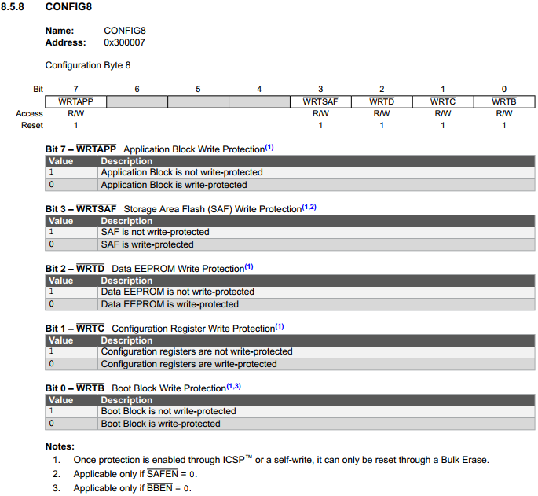
CONFIGURATION BITS

